Slide 1

C Programming
09: Pointers

Slide 2
Static vs. Dynamic Data
We have used fixed size static arrays so far
What if we don’t know how big is enough?
We need dynamic memory allocation
Which means another level of abstraction
Pointers - direct access to memory addresses
The most powerful & dangerous part of C

Slide 3
Variables & Addresses
Memory:
int a=0;
variable address
variable name:
a
0
0x0037b000
variable value

Slide 4
Variables & Addresses
All variables have a location in memory
We use a name to refer to them
The compiler uses a number - i.e. an address
Every byte has a separate number
i.e. memory is just a huge array of bytes
And an integer is just 4 sequential bytes!
A pointer is a variable holding an address

Slide 5

Variables & Addresses
Memory:
variable address
A thing
c
0
0x0037b000
A pointer
p
0x0037b000
0x0037b003
c is char, p is a pointer that points to it:

Slide 6
Pointer Declaration
A pointer variable has a type
type *var-name;
Which consists of a type and a * (asterisk)
e.g.
int *ip; /* pointer to an integer */

Slide 7
Pointer Declaration
E.g.
int *ip; /* pointer to an integer */
double *dp; /* pointer to a double */
float *fp; /* pointer to a float */
char *ch /* pointer to a character */

Slide 8
How to Use Pointers?
There are a few important operations, which we will do with the help of pointers very frequently.
(a) We define a pointer variable,
(b) assign the address of a variable to a pointer and
(c) finally access the value at the address available in the pointer variable. This is done by using unary operator * that returns the value of the variable located at the address specified by its operand.

Slide 9
Pointer Operations
Two new operators
unary & (address of): it gives the address of an object.
unary * (dereference): it accesses the object the pointer points to.

Slide 10
Unary &
The unary & (ampersand) retrieves the operand’s address
int x = 1, z[10];
int *ip; /* ip is a pointer to int */
ip = &x; /* ip now points to x */
ip = z; /* ip now points to z */

Slide 11
Unary *
How do we use what a pointer points to?
The unary * operator does this
Uses the pointer’s target as the value
Instead of the memory address in the pointer
i.e. it is the opposite of the unary *

Slide 12
Use of * and &
int x = 1, y = 2, z[10];
int *ip; /* ip is a pointer to int */
ip = &x; /* ip now points to x */
y = *ip; /* y is now 1 */
*ip = 0; /* x is now 0 */
*ip = *ip + 10; /* increment x by 10 */
ip = &z[0]; /* ip now points to z[0] */

Slide 13
Use of * and &
a value
Memory allocation
an address
4 bytes
1000
10
a
1004
3.5
b
int a=10,c=5;
float b=3.5;
int *p = &a;
1008
5
c
a address
1023
1000
p
pointer
a -is int variable，store value
p -is pointer, store address
address=pointer

Slide 14
Use of * and &
*get the content, & get the address
int i, *p; p = &i; *p = 0; // i = ?
int *p, a[10]; p = a; *p = 0; // a[0] = ?
int *p, a[10]; p = &a[5]; *p = 0; // a[5] = ?
i = 0 *p⇔ i
a[0] = 0 *p⇔ a[0]
a[5] = 0 *p⇔ a[0]

Slide 15
Pointers and Arrays
int a[10];
The notation a[i] refers to the i+1-th element of the array. If pa is a pointer to an integer, declared as
int *pa;

Slide 16
Pointers and Arrays
Then the assignment:
pa = &a[0];
sets pa to point to element zero of a; that is, pa contains the address of a[0].
int x = *pa;
will copy the contents of a[0] into x.

Slide 17
Accessing Array Elements
How do we access array elements?
i.e. what exactly does a[i] mean?
Remember that the computer uses addresses
It has to work out where a[i] is in memory
i.e. a[i] is an operator with two operands:
The address of a[i] is the (hidden) result

Slide 18

Arrays in Memory
The Code:
1000
1001
1002
1003
1004
1005
1006
1007
1008
1009
c is the name of the array
1000 is the address of the array
(i.e. where it starts in memory)

Slide 19
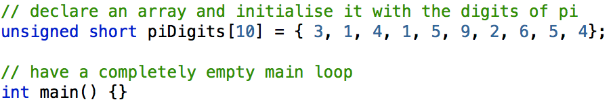
With Short Integers
0001000 03 00 01 00 04 00 01 00 05 00 09 00 02 00 06 00
0001010 05 00 04 00 00 00 00 00 00 00 00 00 00 00 00 00
Each digit now takes 2 bytes
And they are in reverse (little-endian) order
So the computation changes

Slide 20
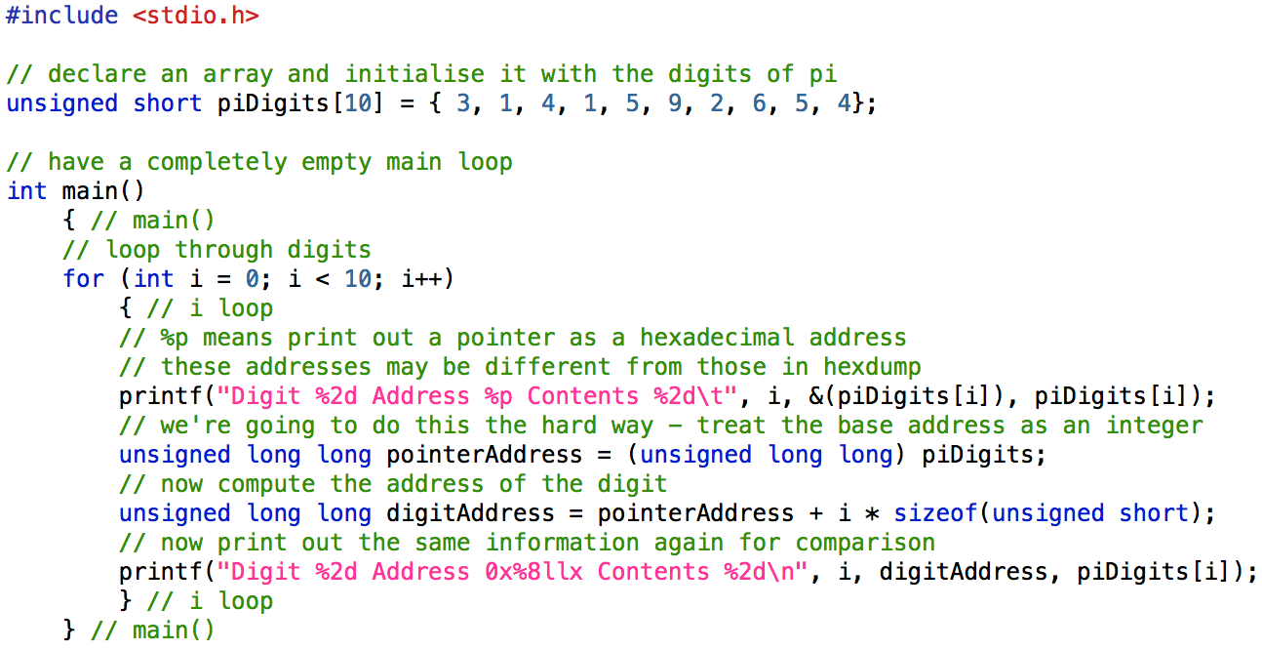
Printing Addresses Out

Slide 21
Output
Digit 0 Address 0x109de1020 Contents 3 Digit 0 Address 0x109de1020 Contents 3
Digit 1 Address 0x109de1022 Contents 1 Digit 1 Address 0x109de1022 Contents 1
Digit 2 Address 0x109de1024 Contents 4 Digit 2 Address 0x109de1024 Contents 4
Digit 3 Address 0x109de1026 Contents 1 Digit 3 Address 0x109de1026 Contents 1
Digit 4 Address 0x109de1028 Contents 5 Digit 4 Address 0x109de1028 Contents 5
Digit 5 Address 0x109de102a Contents 9 Digit 5 Address 0x109de102a Contents 9
Digit 6 Address 0x109de102c Contents 2 Digit 6 Address 0x109de102c Contents 2
Digit 7 Address 0x109de102e Contents 6 Digit 7 Address 0x109de102e Contents 6
Digit 8 Address 0x109de1030 Contents 5 Digit 8 Address 0x109de1030 Contents 5
Digit 9 Address 0x109de1032 Contents 4 Digit 9 Address 0x109de1032 Contents 4
In practice, C knows how to do this
It multiplies by the size of the type
Meaning we can do pointer arithmetic

Slide 22
Pointer Arithmetic
There are four arithmetic operators that can be used in pointers: + 、 - 、 ++ 、 --
By definition pa+1 points to the next element, pa+i points i elements after pa, and pa-i points i elements before.
∗(ptr+i) ⇔ ptr[i]

Slide 23
Pointer Arithmetic
You can apply operators to pointers
pointer ⟵ pointer + integer
pointer ⟵ pointer - integer
integer ⟵ pointer - pointer
pointer += integer,
pointer++, ++pointer, --pointer, pointer--
+1 means +1*sizeof(type)

Slide 24
Pointer Arithmetic
A reference to a[i] can also be written as *(a+i)
In evaluating a[i], C converts it to *(a+i) immediately; the two forms are equivalent.
a[i]⇔∗(a+i)
∗(ptr+i) ⇔ ptr[i]

Slide 25
Arrays Are Pointers
An array is just a pointer to some memory
With an index operator &a[i]
Which is equivalent to a+i
So pointers and arrays are interchangeable
int a[10], *p; p = a;
p[i] is equivalent to a[i]
We’ll leave multi-dimensional arrays alone for now

Slide 26
Arrays Are Pointers
So pointers and arrays are interchangeable
int a[10], *p; p = a;
p[i] is equivalent to a[i]
a[i] ⇔ ∗(a+i) ⇔ ∗(p+i) ⇔ p[i]
&a[i] ⇔ a+i ⇔ p+i ⇔ &p[i]

Slide 27
Initialising Pointers
Pointers are a form of variable
initialise before use
int x = 0; int *p = &x;
Can not be assigned with a constant value.
int *p = 1000;
if paranoid, always initialise to:
a special value, NULL, in <stdlib.h>
int *p = NULL;

Slide 28
Assigning to Pointers
We can assign a literal array to a pointer
char *myName = “Hamish Carr”;
Or we can assign the address of a variable
char *aName = myName;
char **namePointer = &(myName);
Or we can assign the address of a function!
(void *) fPtr = &main;

Slide 29
Example
Read in a string and count the number of character ‘A’
#include "stdio.h"
void main()
{char s[81] ; int k ,n=0;
printf("Input a string:\n");gets(s);
for(k=0;s[k];k++) if(s[k]== 'A') n++;
printf("n=%d\n",n);
}

Slide 30
BY Pointer 1
#include "stdio.h"
void main()
{ char s[81],*p ; int k ,n=0;
p=s;
printf("Input a string:\n");gets(p);
for(k=0;p[k];k++) if(p[k]== 'A') n++;
printf("n=%d\n",n);
}

Slide 31
BY Pointer 2
#include "stdio.h"
void main()
{ char s[81],*p ; int k ,n=0;
p=s;
printf("Input a string:\n");gets(p);
for(k=0;*p;p++) if(*p== 'A') n++;
printf("n=%d\n",n);
}

Slide 32
Exercise
By pointer
Read in 10 scores and compute the average score
Output the maximum and minimum number in an array
Output the positive number in an array
Finding the String Length
Read in a string and count the number of character ‘A’
String Copy

Slide 33
Exercise
By pointer
Read in a string, change the elements and store in reverse order,output the result. It is required that the algorithm should not create an new array space

Slide 34
指针基本操作
1.指针运算
(1)指针加减整型表达式n: 仍得同类型指针
运算规则：地址值增减n倍对象类型长度
例：long a[]={1,2,3,4},∗p=a;
p=a+2; /*p指向元素a[2], 即p=&a[2]; */
p存储的地址值实际增加了2∗sizeof(long)
p++; /*相当于p=p+1; 即p指向下一个对象*/
Notes:
中文参考页

Slide 35
指针基本操作
特殊表达式：
(a) ∗p++; 和 ∗p--;
先取用对象，然后p自加减1
(b) ++∗p;⇔ ∗++p;
--∗p; ⇔ ∗--p;
这四种形式都是p先自加减1，然后再取用对象
对比：++(∗p); (∗p)++; --(∗p); (∗p)--;
这是对象自加减1

Slide 36
指针基本操作
(2) 两个对象类型相同的指针进行加法运算
例：int ∗p, ∗q, ∗s; s=p+q; /*合法但无用处*/
(3) 两个对象类型相同的指针进行减法运算:
得相距的对象长度的倍数(可正可负)
例：int a[5], ∗p, ∗q;
p=&a[3]; q=a+1;则
p−q=2而q−p= −2
(4) 两个指针可以比较大小: 比地址值大小
例：int a[5], ∗p, ∗q;
p=&a[3];q=a; 则
p>q＝1而p<q＝0

